Slide 1
Exploring Tor Browser: Anonymity and Privacy Online
A Lesson on Using the Tor Network
Presented by: Sam Mendez

Slide 2
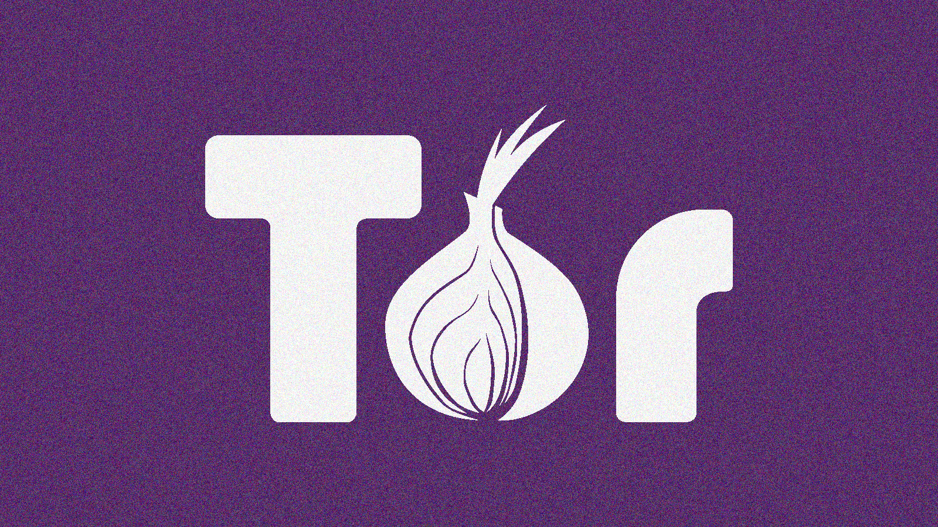
What is Tor?
Tor (The Onion Router) is a free and open-source software for anonymous communication
Main Goal: To protect user’s Privacy by hiding location and usage from surveillance and traffic analysis
How it Works: Data is encrypted and routed through multiple volunteer-operated servers (called nodes)

Slide 3
How the Tor Network Works
Data goes through Entry Node (first relay)
Travels to the Middle Node (Second relay)
Finally, exits through the Exit node

Slide 4
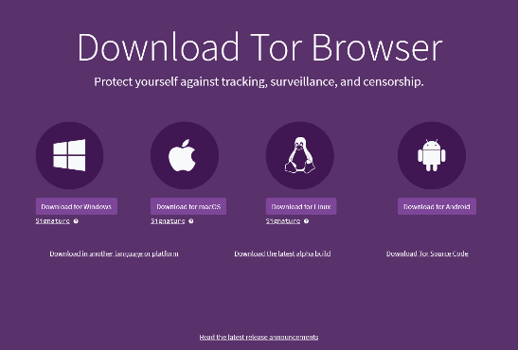
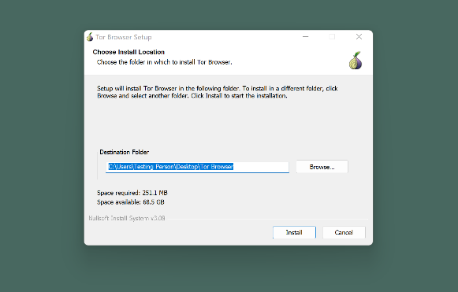
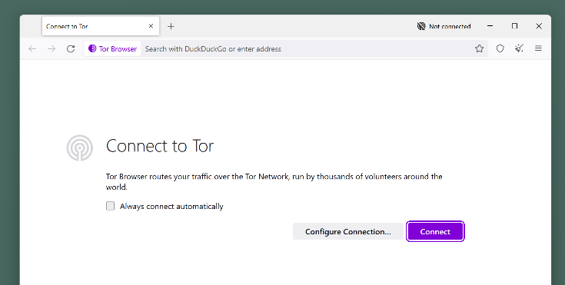
Step by Step Installation
Go to official website (https://www.torproject.org/)
Download the Tor Browser for you Operating System
Install and open the Tor Browser
Click on “Connect” to start browsing anonymously

Slide 5
Demonstration

Slide 6

Exploring Tor Sites
Hidden Wiki: A directory of .onion links for various types of content
SecureDrop: A platform used by whistleblowers to share information anonymously with journalist
Darknet Marketplace: Websites offering illegal goods or services (drugs, coutefeit money, etc.)

Slide 7
Legal and Ethical implications
Positive Use
Negative Use
Protects privacy by hiding IP addresses and encrypting traffic
Enables freedom of speech in countries with censorship
Supports secure communication for journalist and whistleblowers (SecureDrop)
Bypasses government and ISP censorship
Allows secure academic research on sensitive topics
Empowers human rights activists to organize anonymously
Enhances secure web browsing, protecting against surveillance
Access to illegal marketplace for drugs, weapons, and counterfeit goods
Facilitates cybercrime, including hacking and malware distribution
Used for human trafficking and illicit services
Enables fraudulent activities like credit card fraud and identity theft
Conducts illegal financial transactions (money laundering)
Distributes illegal content (child exploitation)
Aids in anonymous terrorist communication and propaganda

Slide 8
Conclusion
Tor offers a powerful way to protect privacy online, but it also comes with risks. It is important to understand how to use it responsibly
Whether you’re exploring the surface web or dark web, always ensure you’re adhering to ethical and legal standards

